Slide 1

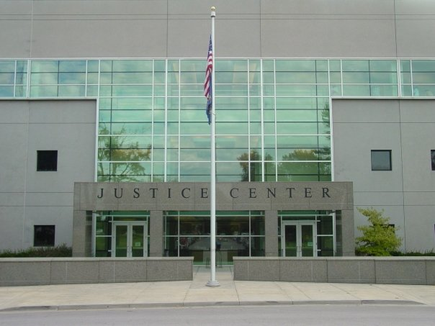
Leavenworth Police Department
2021 Annual Report

Slide 2
Leavenworth Police Department Organizational Chart
Chief of Police
Secretary
Deputy Chief of Police
Administrative Sgt.
SRO
Support Services Lt.
Investigations Lt.
Technical Sgt.
Operations Lt.
Animal Control Supervisor
Administrative Specialist
Dispatch Sgt.
Records Supervisor
Municipal Court Liaison
Detective Sgt.
Evidence Custodian
Animal Control Officers
Dispatchers
Records Clerks
Detectives
Night Shift Sgt. (2)
Afternoon Shift Sgt. (2)
Day Shift Sgt. (2)
Traffic Sergeant
Kennel Attendants
Administrative Clerk
Patrol Officers
Patrol Officers
Patrol Officers
Traffic Officers
Records Clerk

Slide 3
Message from Chief Kitchens
The men and women of the Leavenworth Police Department are proud to present the 2021 Annual Report. Officers and employees continued to meet the challenges of the COVID-19 pandemic with great determination and spirit.
The overall crime rate in the City of Leavenworth went down 14%. Part 1 and Part 2 Crimes are both down significantly. We continue to deal with the tragedy of Domestic Violence as our primary source of calls for service but they were down in 2021.
The law enforcement profession continues to focus our efforts on hiring and retention. We have remained generally steady with staffing that is reflected by an average of six vacant positions. This trend is occurring all across the nation.

Slide 4
Police Department Employee Longevity
(in years)

Slide 5
Annual City Budget
Dollar Comparison

Slide 6
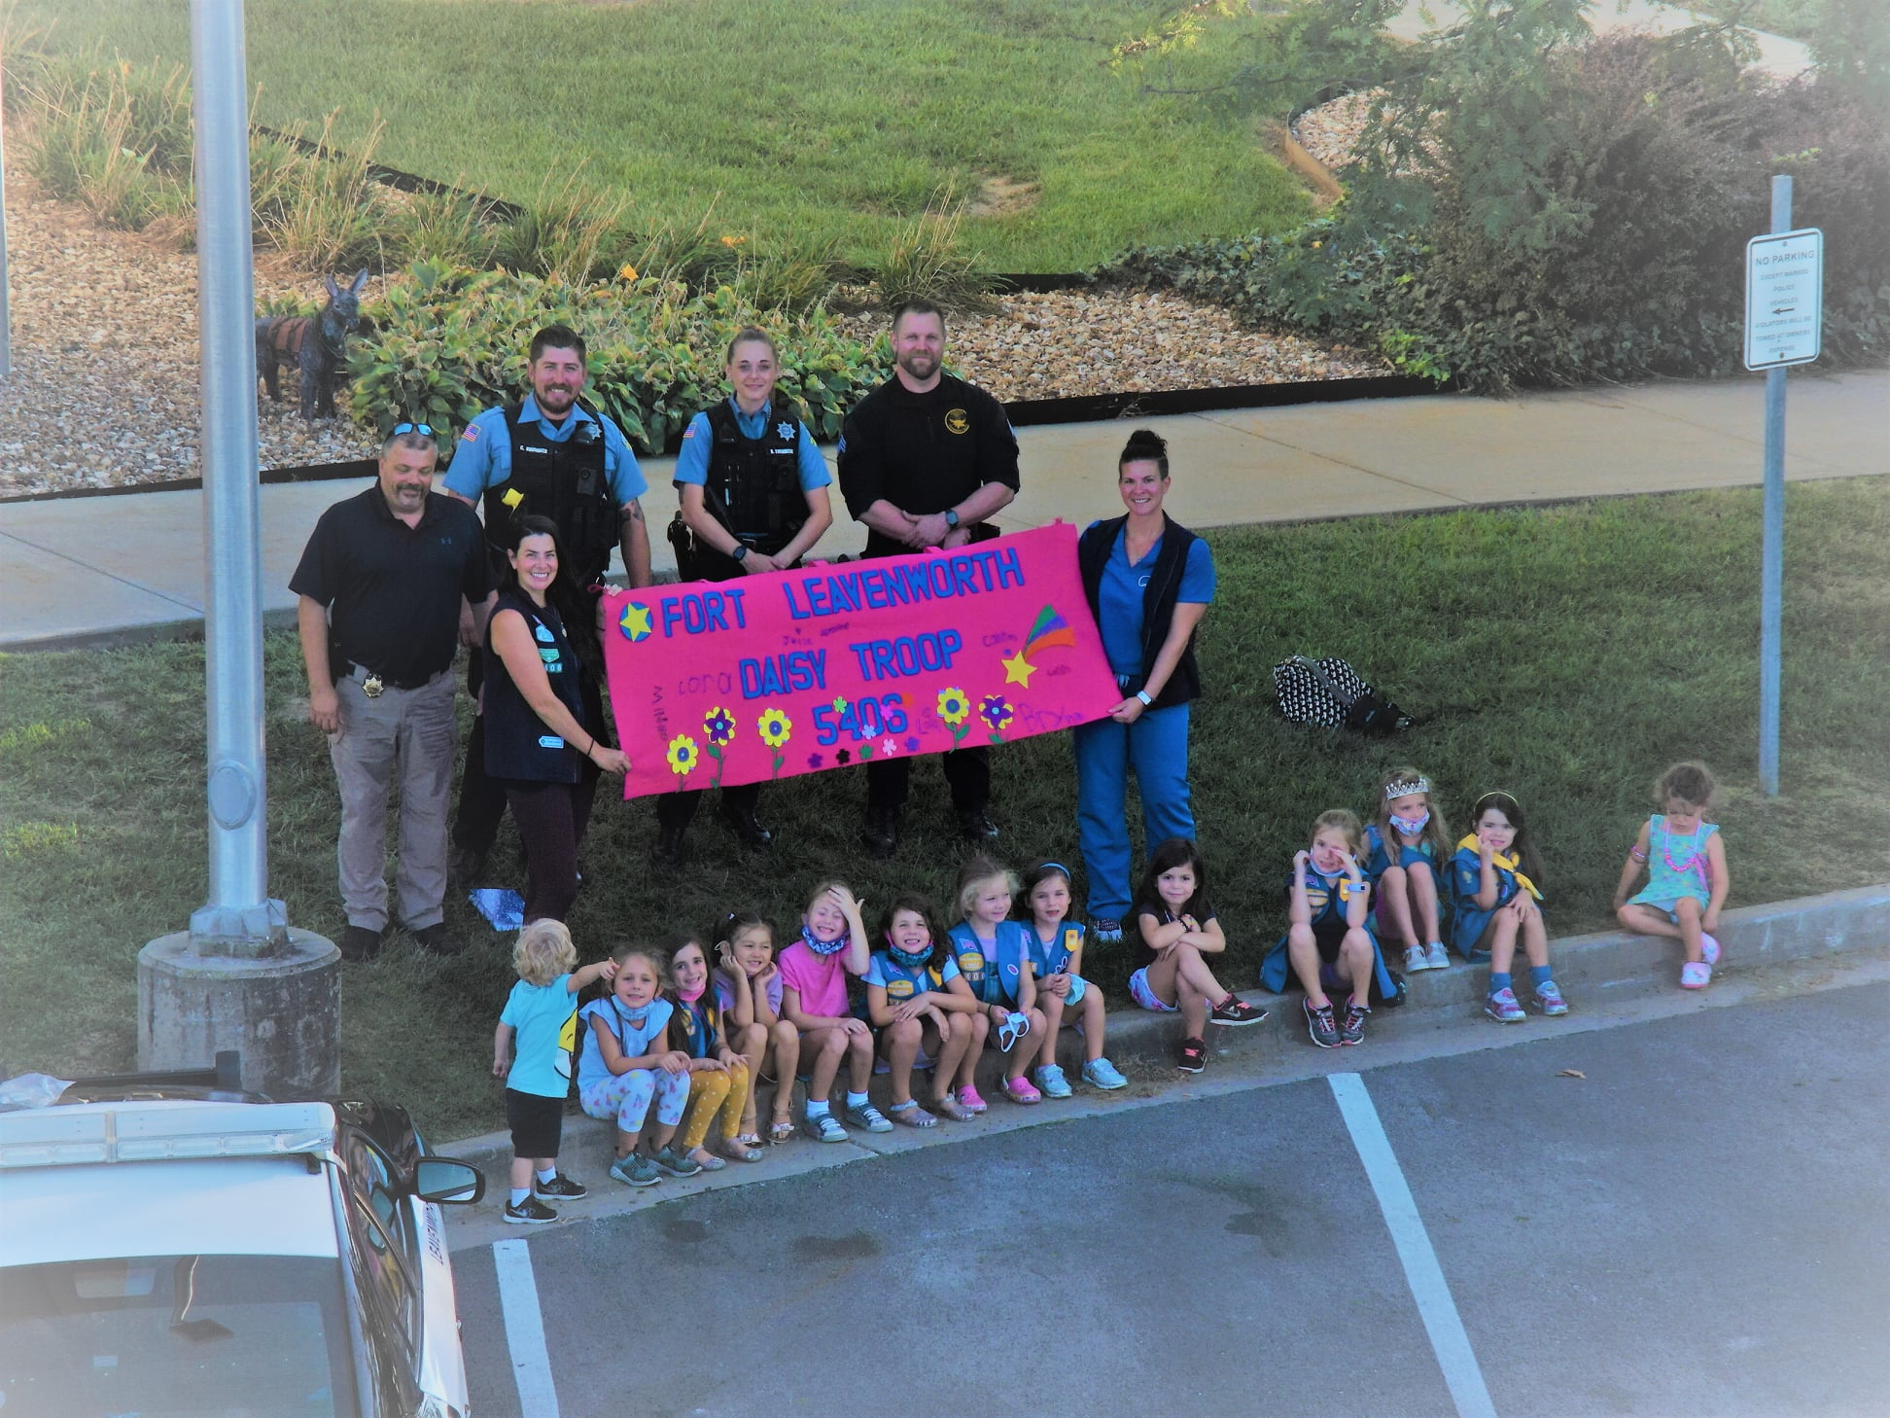
Community Engagement

Slide 7
Calls For Service

Slide 8
Part 1 & Part 2 Crimes

Slide 9
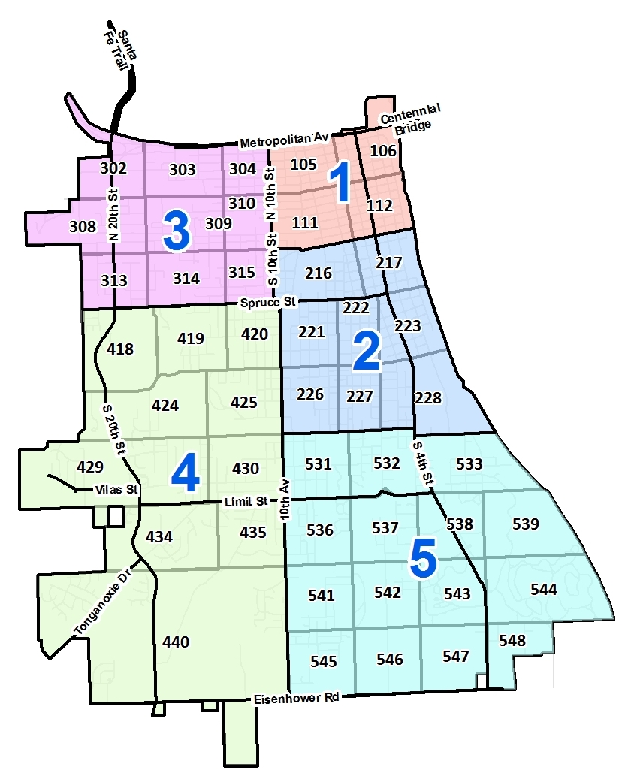
Criminal Activity – Persons 2021
Area | Homicides | Rape | Robberies | Assaults
1 | 1 | 12 | 9 | 126
2 | 0 | 15 | 5 | 103
3 | 0 | 5 | 0 | 90
4 | 0 | 6 | 1 | 57
5 | 3 | 16 | 9 | 197

Slide 10
Criminal Activity Persons – 10 Year Trend

Slide 11
Criminal Activity – Property 2021
Area | Theft | Auto Theft | Burglaries | Arson
1 | 85 | 39 | 81 | 3
2 | 122 | 43 | 78 | 3
3 | 35 | 24 | 57 | 3
4 | 56 | 13 | 35 | 3
5 | 123 | 29 | 76 | 2

Slide 12
Criminal Activity Property– 10 Year Trend

Slide 13
Part 1 Crimes Reported
Part 1 crimes include:
Murder
Rape
Robbery
Assault
Burglary
Theft
Auto Theft

Slide 14
Clearances
Percent of Part 1 Crimes Cleared

Slide 15
Part 2 Crimes Reported
Part 2 crimes include all criminal events not included in the Part 1 index.

Slide 16
Clearances
Percent of Part 2 Crimes Cleared

Slide 17
Clearances
Percent of Part I & II Crimes Cleared

Slide 18
Mental Health
In the last several years the issue of mental health has risen to one of the more difficult and dangerous calls that police officers deal with.

Slide 19
Detective Division
Cases Handled

Slide 20
Arrests

Slide 21
Arrests by Area 2021

Slide 22
Battery LEO

Slide 23
Domestic Cases

Slide 24

Domestic Arrests 2021

Slide 25
Narcotics Enforcement
Activity
Seizures

Slide 26
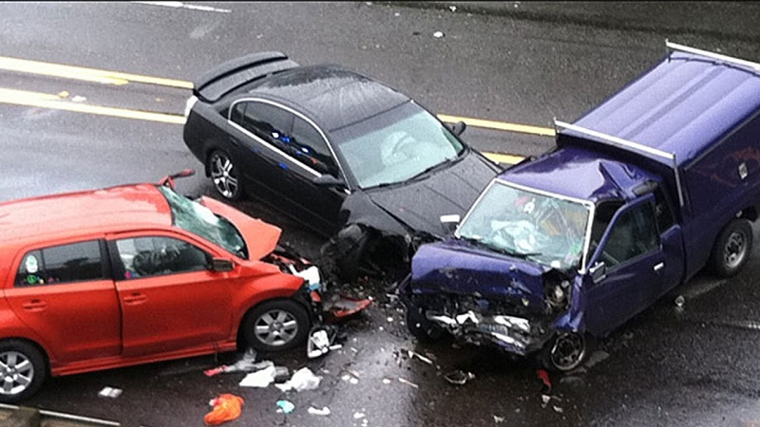
Traffic Accidents

Slide 27
All Citations

Slide 28
Traffic Citations 2021
__________
Total Traffic Citations 1,983

Slide 29
Top Traffic Accident Locations 2021

Slide 30
DUI Arrests/Alcohol Related Accidents

Slide 31
Professional Standards Investigations
A Professional Standards Investigation follows any critical event or complaint about the conduct of an officer. Other officers, supervisors, or citizens may initiate this.

Slide 32
Professional Standards Investigations

Slide 34
Use of Force by Race & Gender

Slide 35
Bomb Unit

Slide 36
Fire Calls Processed by PD Communications

Slide 37
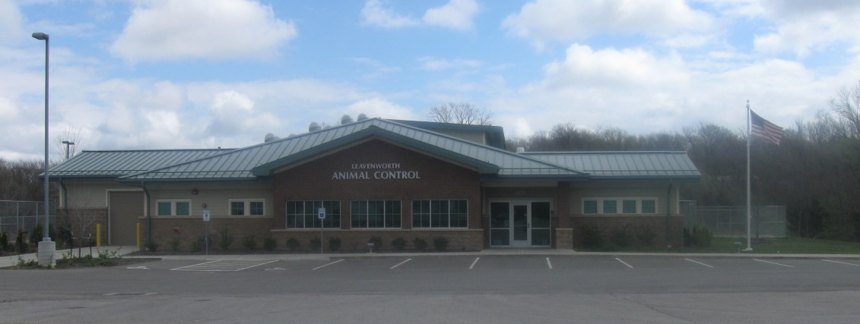
Animal Control

Slide 38
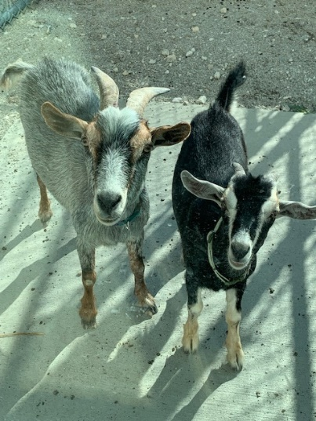
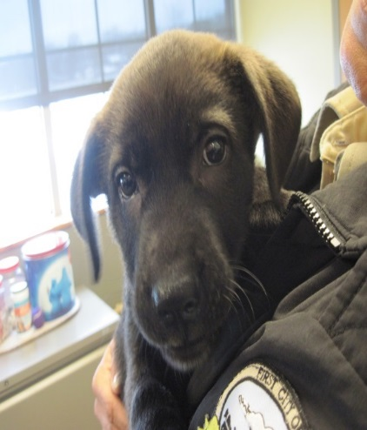
Animals Handled

Slide 39
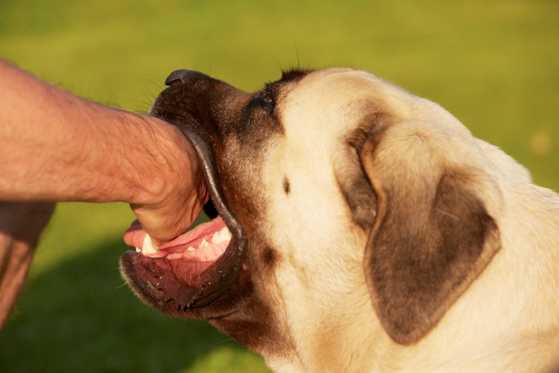

Bite Cases

Slide 40
Animal Ordinance Enforcement

