Slide 1
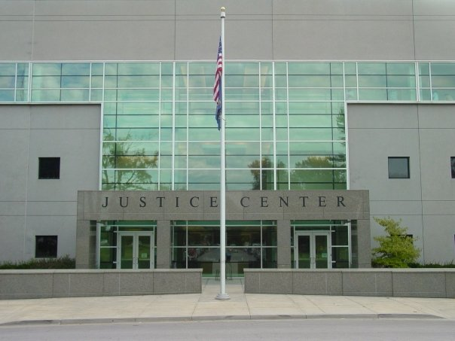
Leavenworth Police Department 2024 Annual Report

Slide 2
Leavenworth Police Department Organizational Chart
Chief of Police
Secretary
Deputy Chief of Police
Administrative Sgt.
SRO
Support Services Lt.
Investigations Lt.
Technical Sgt.
Operations Lt.
Animal Control Supervisor
Administrative Specialist
Dispatch Sgt.
Records Supervisor
Municipal Court Liaison
Detective Sgt.
Evidence Custodian
Animal Control Officers
Dispatchers
Records Clerks
Detectives (8)
Night Shift Sgt. (2)
Afternoon Shift Sgt. (2)
Day Shift Sgt. (2)
Traffic Sergeant
Kennel Attendants
Administrative Clerk
Patrol Officers
(9)
Patrol Officers
(9)
Patrol Officers
(9)
Traffic Officers
(3)
Records Clerk
The Organizational Chart for the Leavenworth Police Department is established to ensure continued operations in the event of catastrophe. The Deputy Chief of Police is fully trained and experienced in all matters should it become necessary to fulfill the role of Chief of Police. Throughout the year the agency spends considerable time and effort training and preparing Officers for promotion and the transition to leadership roles. Several times each year, employees are appointed and serve in an acting role such as Acting Lieutenant or Acting Chief of Police. This helps people transition to positions of greater responsibility!

Slide 3
Message from Chief Kitchens
The men and women of the Leavenworth Police Department are proud to present the 2024 Annual Report. Officers and employees continued to meet the challenges of providing for the public safety of our community with great spirit.
The crime rate for Leavenworth rose in 2024. Our calls for service were down by a small amount. We continue to spend considerable time and effort on Domestic Violence, Mental Illness, Drug Investigations, and Property Crimes.
The law enforcement profession continues to focus our efforts on hiring and retention. We have been presented with serious staffing challenges, as Police Officers continue to take advantage of a highly competitive marketplace.

Slide 4
Police Department Employee Longevity
(in years)

Slide 5
Annual City Budget Dollar Comparison

Slide 6
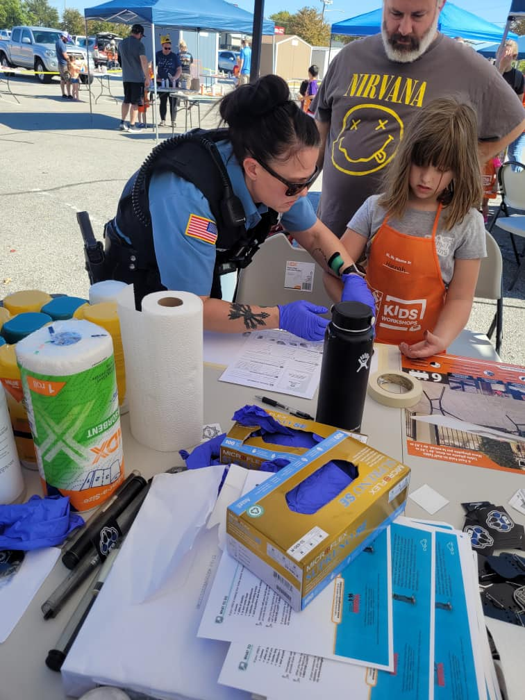
Community Engagement

Slide 7
Calls For Service

Slide 8
Part 1 & Part 2 Crimes

Slide 9
Domestic Cases

Slide 10
Mental Health
Mental Health Co-Responder
Call out | 45
Collaboration | 283
Initial Contact | 238
Repeat Contact | 279
Telephone | 213
Self-Initiated | 326
Outreach Attempt | 29
Total | 1413

Slide 11
Criminal Activity – Persons 2024
Area | Homicides | Rape | Robberies | Assaults
1 | 0 | 10 | 8 | 97
2 | 0 | 14 | 3 | 79
3 | 0 | 8 | 2 | 85
4 | 0 | 10 | 2 | 72
5 | 0 | 8 | 4 | 162

Slide 12
Criminal Activity Persons – 10 Year Trend

Slide 13
Criminal Activity – Property 2024
Area | Theft | Auto Theft | Burglaries | Arson
1 | 145 | 20 | 72 | 0
2 | 149 | 49 | 71 | 0
3 | 57 | 22 | 24 | 0
4 | 108 | 15 | 31 | 0
5 | 133 | 35 | 77 | 0

Slide 14
Criminal Activity Property– 10 Year Trend

Slide 15
Part 1 Crimes Reported
Part 1 crimes include:
Murder
Rape
Robbery
Assault
Burglary
Theft
Auto Theft

Slide 16
Clearances Percent of Part 1 Crimes Cleared

Slide 17
Part 2 Crimes Reported Part 2 crimes include all criminal events not included in the Part 1 index.

Slide 18
Clearances Percent of Part 2 Crimes Cleared

Slide 19
Clearances Percent of Part I & II Crimes Cleared

Slide 20
Detective Division
Cases Handled

Slide 21
Arrests

Slide 22
Arrests by Area 2024

Slide 23
Domestic Arrests 2024

Slide 24
Narcotics Enforcement
Activity
Drug Chart

Slide 25
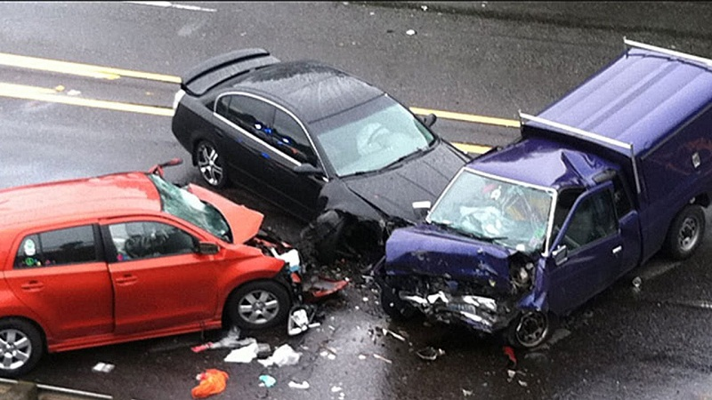
Traffic Accidents

Slide 26
All Citations

Slide 27
Traffic Citations 2024
__________
Total Traffic Citations 1973

Slide 28
Top Traffic Accident Locations 2024

Slide 29
DUI Arrests/Alcohol Related Accidents

Slide 30
Professional Standards Investigations
A Professional Standards Investigation follows any critical event or complaint about the conduct of an officer. Other officers, supervisors, or citizens may initiate this.

Slide 31
Professional Standards Investigations

Slide 33
Use of Force by Race & Gender

Slide 34
Battery LEO

Slide 35
Bomb Unit

Slide 36
Fire Calls Processed by PD Communications

Slide 37
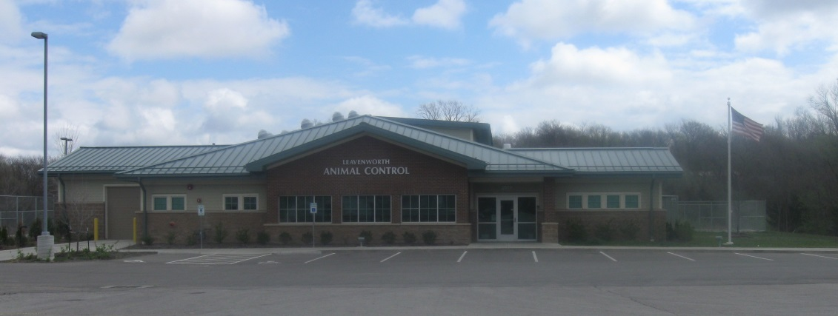
Animal Control

Slide 38
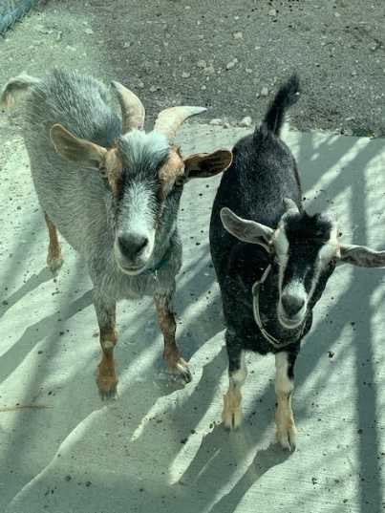
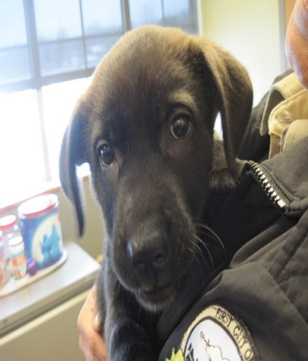
Animals Handled

Slide 39
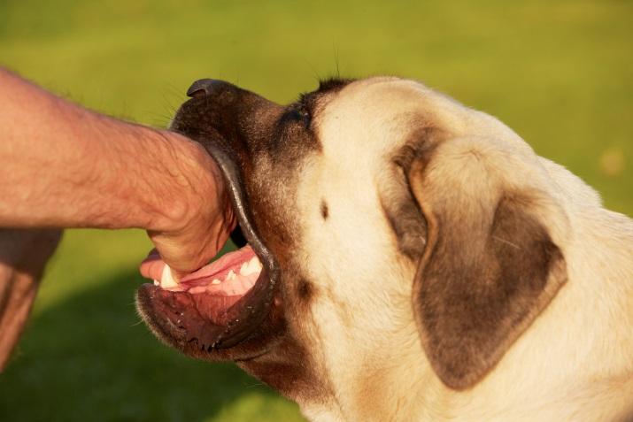
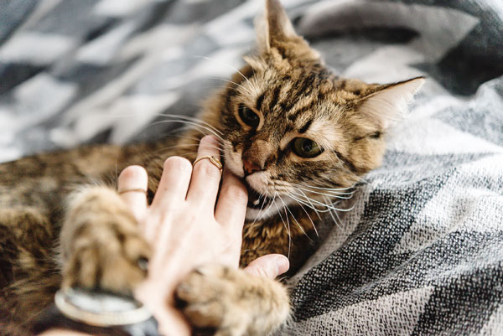
Bite Cases

Slide 40
Animal Ordinance Enforcement

