Slide 1


KU Small Business Development Center
Advising. Consulting. Training. Growing Entrepreneurs
Notes:
Kristina

Slide 2

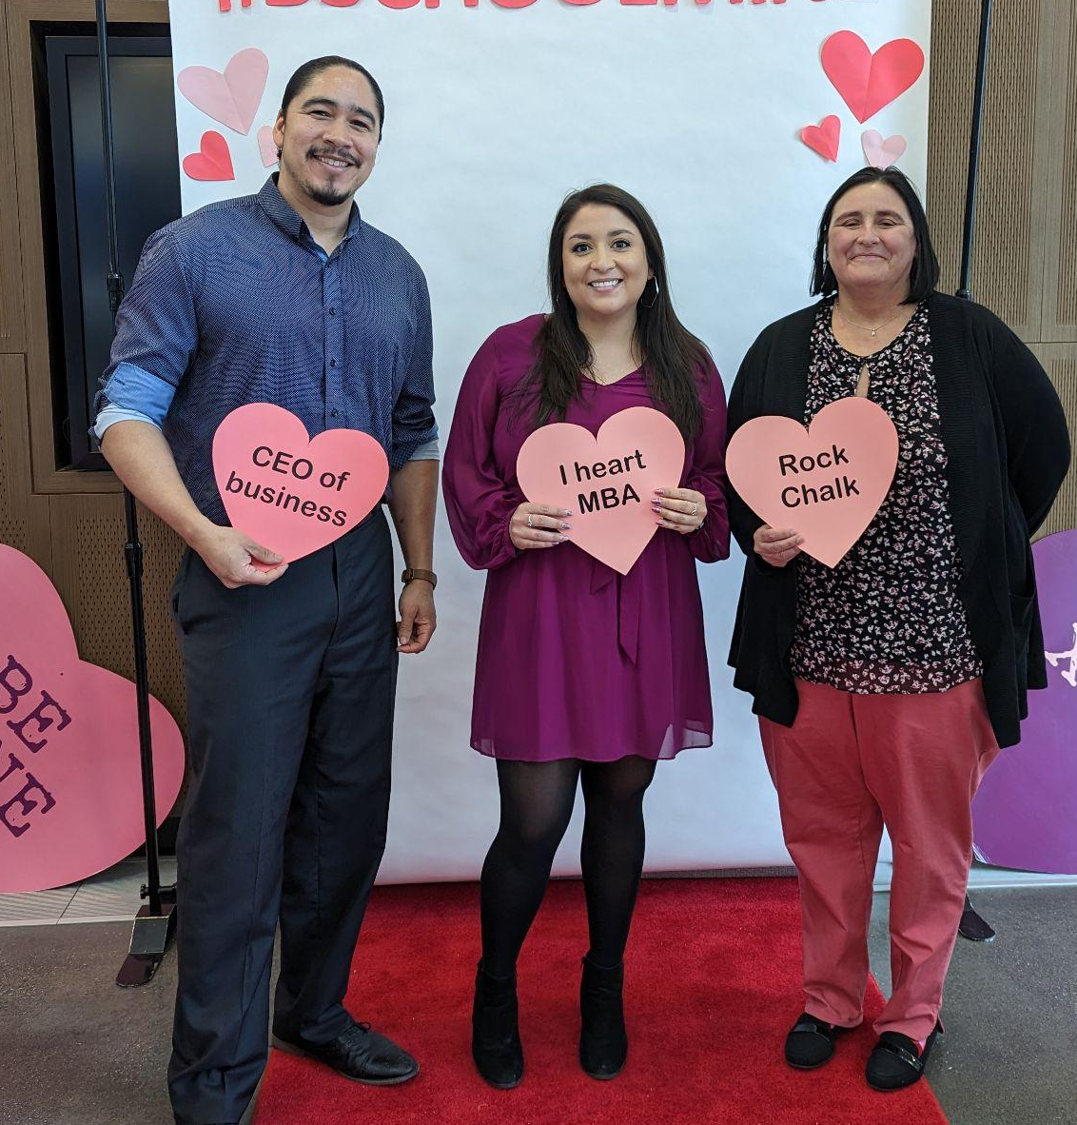
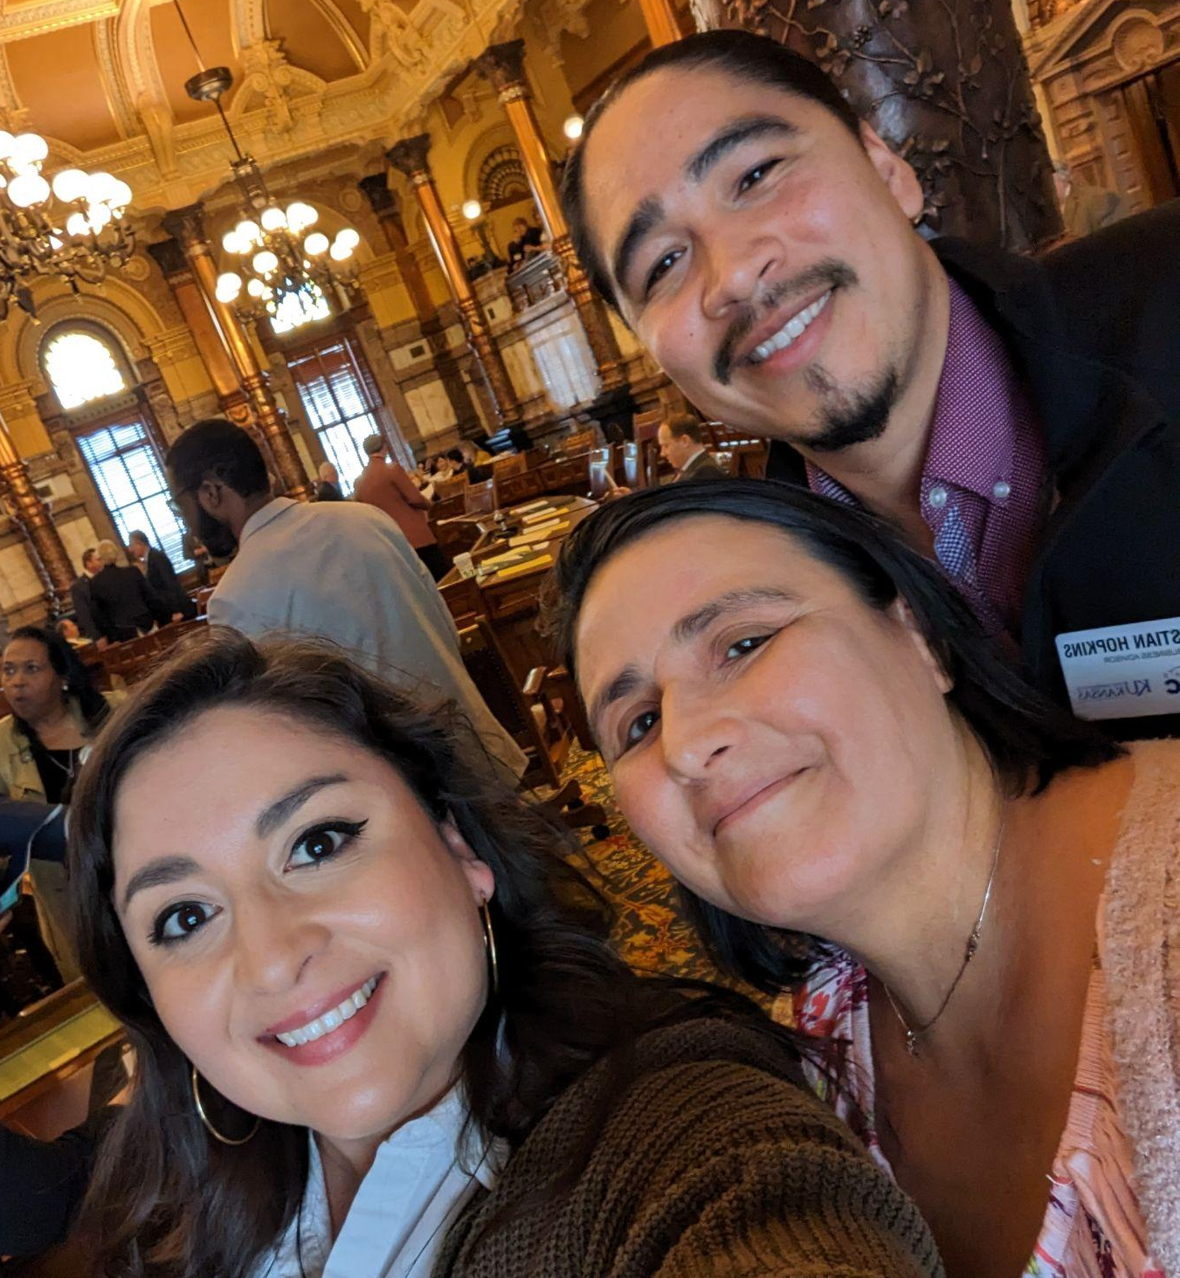
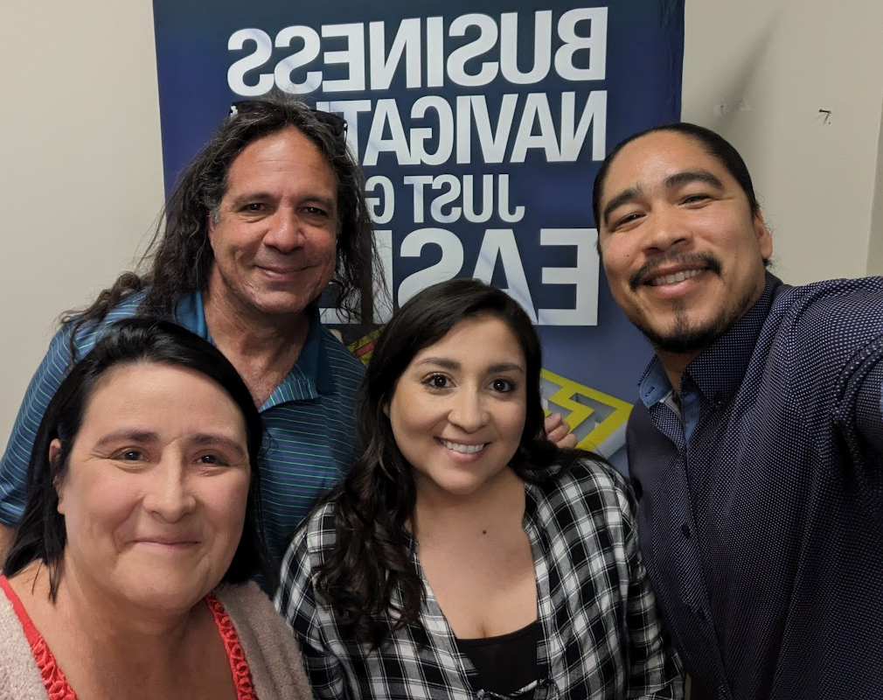
OUR TEAM
Kristina Edwards,
Regional Director
Carrie Poe,
Business Advisor
Christian Hopkins, Business Advisor
Will Katz,
Business Advisor
Notes:
Kristina

Slide 3
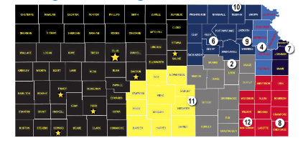
Kansas Small Business Development Center
NATIONWIDE NETWORK OF SMALL BUSINESS DEVELOPMENT CENTERS PROVIDING FREE CONSULTING TO BUSINESSES ALL TYPES
Part of a network of 11 SBDC’s in Kansas and 1,100 across the country
Serving Douglas, Franklin, Leavenworth, Jefferson, Atchison, and Doniphan County
Notes:
Kristina

Slide 4
Our Mission
Help more people!
Our Vision
Grow Kansas one small business at a time.
Notes:
Carrie Our mission is simple and straightforward! We are here to help more people and to do so we are growing Kansas one small business at a time!

Slide 5
What We Do
Individual, one-to-one FREE and confidential advising for start-up AND existing businesses
Focused trainings + content providers
Connection to appropriate resources
Community Partnerships
Notes:
Carrie - We have several ways we accomplish our mission The main way we do so is by providing free and confidential advising services where we sit down and listen to our clients. Our team serves about 400 clients a year and that number is growing! We also support community organizations like we are today by providing presentations on specific content areas!

Slide 6
Advising Services
Business Planning
Cash Flow Management
Financial Analysis
Sales and Business Development
Employee Management
Market and Consumer Research
Marketing and Social Media
Business Valuation
Notes:
CARRIE - Sometimes our advising services are brainstorming strategies, gathering and sharing data, equipping clients with new skills or being a listening ally. The Kauffman Foundation recently shared a study that indicated a key success factor in business ownership is having someone to talk to. We can be that person!

Slide 7
Three Critical Success Factors
Management
Can you manage the business or assemble a team that can?
Market
Is there demand for your product or service and are customers willing to pay you a price to keep you in business?
Money
Do you have the capital or know what you need to run and fund your business?
Notes:
Christian

Slide 8
Money
Do you have the capital or know the amount you need to run and fund your business?
Notes:
Christian

Slide 9
Ask Yourself!?!?!
Do you really understand the ins and outs of our finances?
By asking yourself this question, you have an opportunity to improve. Mistakes are never easy BUT give you an opportunity to correct errors and develop a plan to move forward - more strategically and more empowered!
Notes:
Christian Take a minute to reflect: do you really understand the ins and outs of your finances? Because if your answer is anything other than yes, you need to invest more time in understanding them. Yes, you may find some errors but if you do, you have a chance to improve your business practices. Understanding your finances allows you to feel empowered and make strategic decisions.

Slide 10
Money - Avoidance
Not looking at your cash flow consistently
Avoiding financials because of a lack of understand
Not improving your financial management skills.
Not tracking your cash in or cash out
Notes:
Christian

Slide 11
Money - Reliance
Relying on an outside source to management financials - accounting system, accountant, bookkeeper, employee, partner (business or otherwise)
Assuming / trusting financials are recorded properly
Notes:
Christian

Slide 12
Money - Tips & Tricks
The little things matter.
  Record
  Categorize
  Reconcile
You can learn.
  Learn your sources of revenue
  Understand all of your expenses
  Use benchmarks!
You are not alone!
  You don’t have to have a finance degree to understand your financials. Leverage your network, leverage your resources!
Notes:
Christian - Let’s talk about about a couple money tips and tricks
First the little things DO matter. Critical steps to getting your finances in order include recording ALL your expenses and revenues. Next you need to categorize those expenses so you can better understand where your money is going. Finally, reconcile the bank account and your financial reports because they might not match.
2. You can learn more about money. Examine what your sources of revenue are or could be. Understanding your expenses can include analyzing if you need to find a different supply source to improve your profit margins or get rid of subscriptions you haven’t used after all. Finally, use industry benchmarks to be ensure your practices are optimizing profits.
You are NOT alone in tackling your finances. Leverage your network and your resources!

Slide 13
Market
Is there demand for your product or service and are customers willing to pay you a price to keep you in business?
Notes:
Kristina

Slide 14
Market
Ask yourself:
Do I know who my target market is?
P.S. NOT EVERYONE IS YOUR CUSTOMER!!!
Notes:
Kristina

Slide 15
Market - Leveraging AI
Prompt:
Define target market for Small Business Development Center in Kansas.
Notes:
KRISTINA

Slide 16
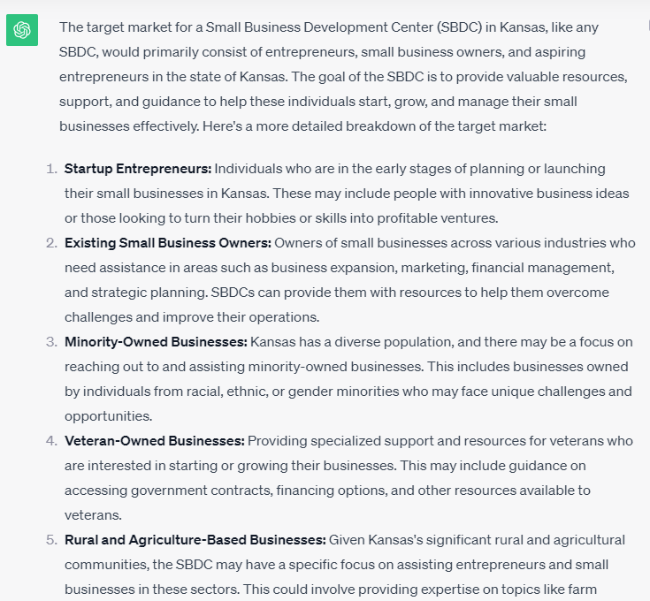
Notes:
KRISTINA

Slide 17
Market - Leveraging AI
Prompt:
Develop Marketing plan for Small Business Development Center in Kansas targeting start up entrepreneurs.
Notes:
KRISTINA

Slide 18
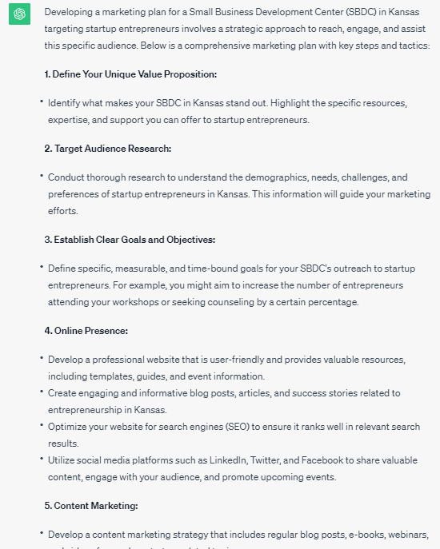
Notes:
KRISTINA

Slide 19
Market - Leveraging AI
Prompt:
Create a Facebook content calendar that markets services offered to start up entrepreneurs at the Small Business Development Center in Kansas
Notes:
KRISTINA

Slide 20
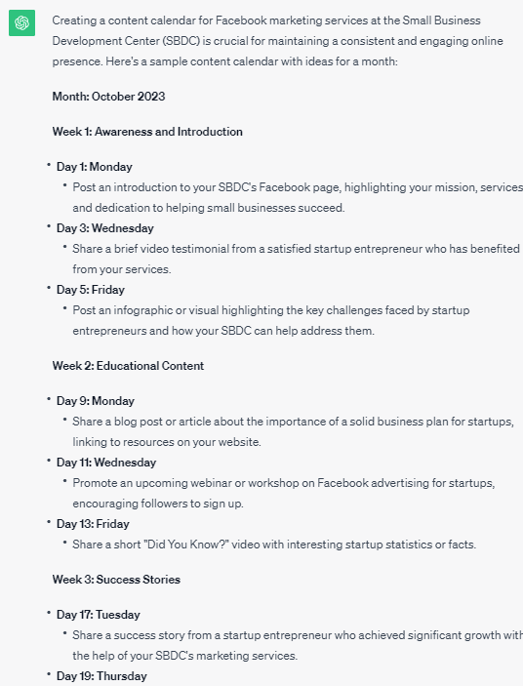
Notes:
KRISTINA

Slide 21
Market - Leveraging AI
Prompt:
Create Facebook post that introduces services offered at a Small Business Development Center in Kansas
Notes:
KRISTINA

Slide 22
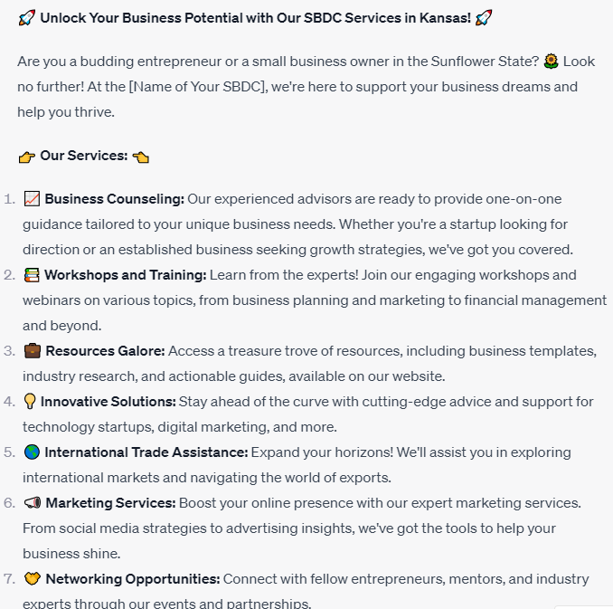
Notes:
KRISTINA

Slide 23
Fun Right?!?!?!
Disclaimer - do not entirely rely on AI
Experiment with prompts
You are not alone - we can help
Notes:
KRISTINA

Slide 24
Management
Can you manage the business or assemble a team that can?
Notes:
CARRIE The 3rd M is Management. Can you manage the business or assemble a team that can?

Slide 25
Management - Top Two!
Working In The Business
AND
2. Working on the Business
Notes:
cARRIE There are two prongs to management. Working in the business is likely the passion or activities that brought you into being in business like creating art, providing therapy to clients, helping someone be financially successful. So working in the business is likely your preferred business activity. But you must also work ON the business for example reconciling your books, hiring, or marketing efforts.

Slide 26
Management
You are not alone
Assemble a team
Employees
Advisors
System of support
Friends & Family
Notes:
KRISTINA

Slide 27
Employees -Hiring Tips
Develop a solid job description
  Don’t forget to tell your story!
  Think about the value YOU have to offer
  Be clear about the skills and qualifications
  Consider a Call-To-Action
Post the job in new spaces
  Social Media Groups
  Networking Newsletters
  Neighborhood Groups
Target Market is not only for marketing to customers!
  Think about demographics / skills previous employees
  Now - where is your target customer consuming information?
Notes:
Carrie

Slide 28
Employees - Retention
No longer what can they do for you; what can you do for them?
Benefits
Education
Empowerment
New Skill Development
Something fun?
Notes:
cARRIE Employee retention is a pressing topic for many business owners. No longer are employers able to only view employees as what can they do for you but now employers must also clearly answer what you can do for your employee. Benefits may be one way you can add value to being your employee. Think creatively it doesn’t have to just be a 401K, it could be offering pet insurance, or being able to have flexibility like working remote 2 days a week. Opportunities for education and even how the employee can feel more empowered in their activities at work will lead to higher retention rates. Consider if there is a way to incorporate something fun into your employment atmosphere like an employee trivia night or family fun night. What way can you build strong connections in your internal community?

Slide 29
Employees - Productivity
Labor as a percentage of revenue
Frequent check-ins
Know what to track
Get to know your employees
  Strengths / Weaknesses
  Learning Style
  Management Style
  What gets them excited
Notes:
Carrie

Slide 30
Gather Support
Advisors
  Friends
  Family
  Subject Matter Experts
    Bankers
    Accountants
    Financial Advisors
    Business Advisors??
You don’t have to know it all! You also don’t have to hire for it all - gather a system of support!
Tip: Management / Market / Money - who can support you in each of these areas?
Notes:
CARRIE Take time to build your management support network. Your network could be family and friends but you also want to build your team of subject matter experts like your banker, insurance agent, financial advisors or even business advisors.
Create your team of business support in all three areas of Management, Market and Money!

Slide 31
Remember 3Ms
Management
Can you manage the business or assemble a team that can?
Market
Is there demand for your product or service and are customers willing to pay you a price to keep you in business?
Money
Do you have the capital or know what you need to run and fund your business?
Notes:
CARRIE Take time to build your management support network. Your network could be family and friends but you also want to build your team of subject matter experts like your banker, insurance agent, financial advisors or even business advisors.
Create your team of business support in all three areas of Management, Market and Money!

Slide 32
How we can help!
Profitcents for benchmarks + Cash Flow
Business plan + marketing tools
Safe space to ask questions + learn more
Connect with local resources
And we are free
Notes:
Christian

Slide 33
Advising. Consulting. Training. Growing Entrepreneurs
Free Tools & Resources
SBA.gov business plan development tools
  Boots to Business program
SCORE.org business plans & startup assistance resources
Connect with your local Women’s Business Center
Connect with your local Veterans Business Outreach Center
Notes:
Christian

Slide 34

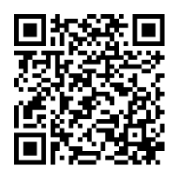

Contact Us!
Email:
kristinamease@ku.edu
hopkinsc@ku.edu
carriepoe@ku.edu
Phone:
785-843-8844
Address:
718 New Hampshire
Lawrence, Kansas
Website:
https://business.ku.edu/research-and-faculty/centers/ku-sbdc
Notes:
Christian

Slide 35

????

