Slide 1

Welcome to

Slide 2
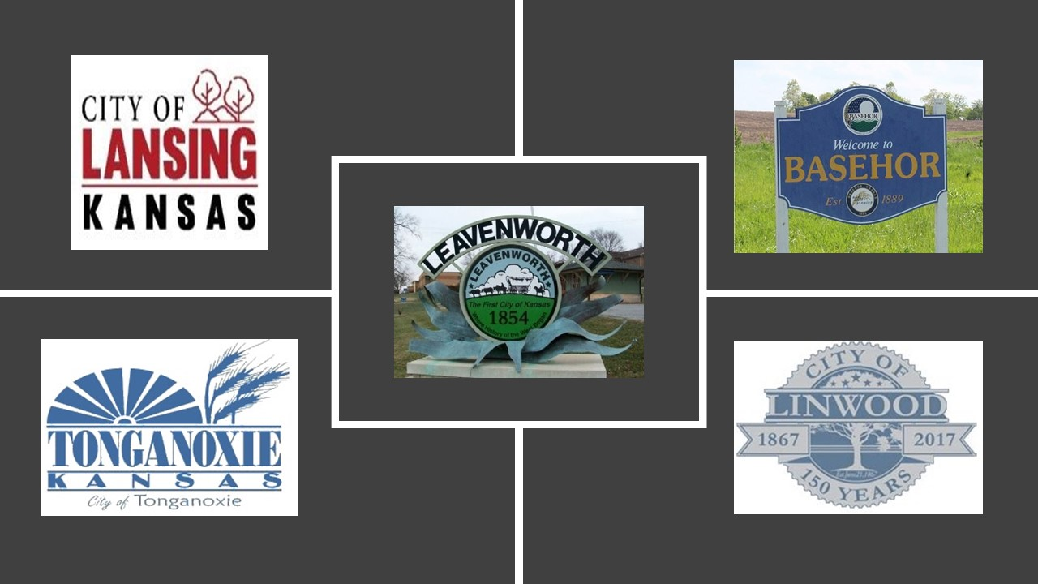
Who We Are
A locally-based non-profit
A board of local volunteers
The loan provider for Network Kansas
A representative of the community's vision to support entrepreneurship

Slide 3

Our Mission
Stimulate economic growth and create jobs throughout the County of Leavenworth, Kansas, by:
Promoting entrepreneurship,
Providing small business educational opportunities,
Implementing Network Kansas programs, and
Providing or coordinating one-on-one business coaching to small business owners.

Slide 4

Our Value Proposition
“Collaboration for economic development in Leavenworth County”
GLC can only fulfill its mission by collaborating with other agencies and centers.

Slide 5
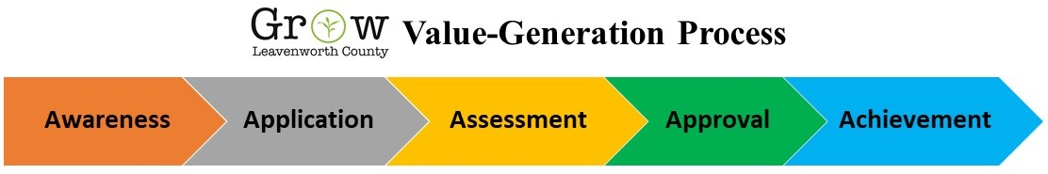
Our Value Generation Process

Slide 6
Form partnerships – Chamber, Main Street, LCDC, City of Leavenworth, City of Lansing
Develop collaborative programs for education and economic development
Advertise programs
Raise operating funds
Educate business leaders about programs and opportunities
Train business owners

Slide 7
Business owners submit loan applications
Administrators verify application readiness
Administrators forward applications to the Financial Review Committee

Slide 8
Financial Review Committee reviews and approves the loan application
Funding Source (NetworkKansas) reviews the application

Slide 9
Funding source approves the loan
Funding source defines payment terms
Business owner accepts the loan agreement

Slide 10
The business thrives
GLC monitors loan performance
GLC and partners offer business training
Business leader pays loan on time

Slide 11
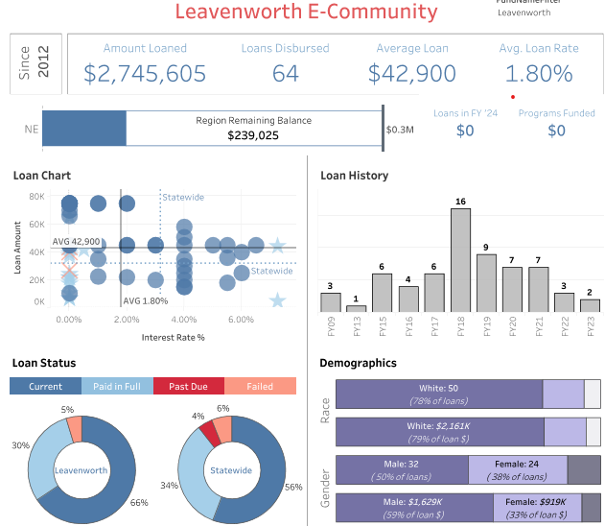
GLC’s
Loan Performance

Slide 12
2023 Year in Review
Reorganization of the Board
Lenders’ Lunch Program
YEC 2023
Destination Creation Workshop
2 loans approved

Slide 13
2024 Activities
Reform the Board – Fill open seats and designate a Secretary.
Conduct YEC 2024
Conduct two to three training events

