Slide 1


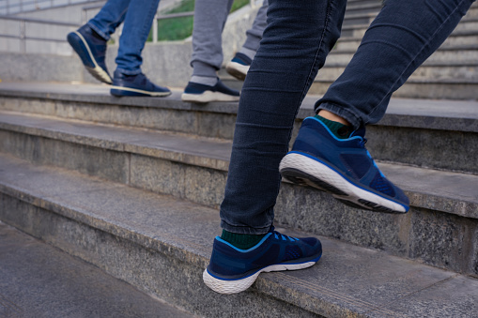
Your Next Step: City Grants
Penny Holler
Assistant City Manager
100 N. 5th Street
Leavenworth, KS 66048
(913) 680-2602
Penny.Holler@FirstCity.org
www.LeavenworthKS.org/ED

Slide 2
3 City Business Grants
ADA Accessible Grant
NEW – Business Improvement and Expansion Grant
Small Business Economic Development Grant
MUST HAVE GRANT APPROVAL BEFORE WORK BEGINS

Slide 3
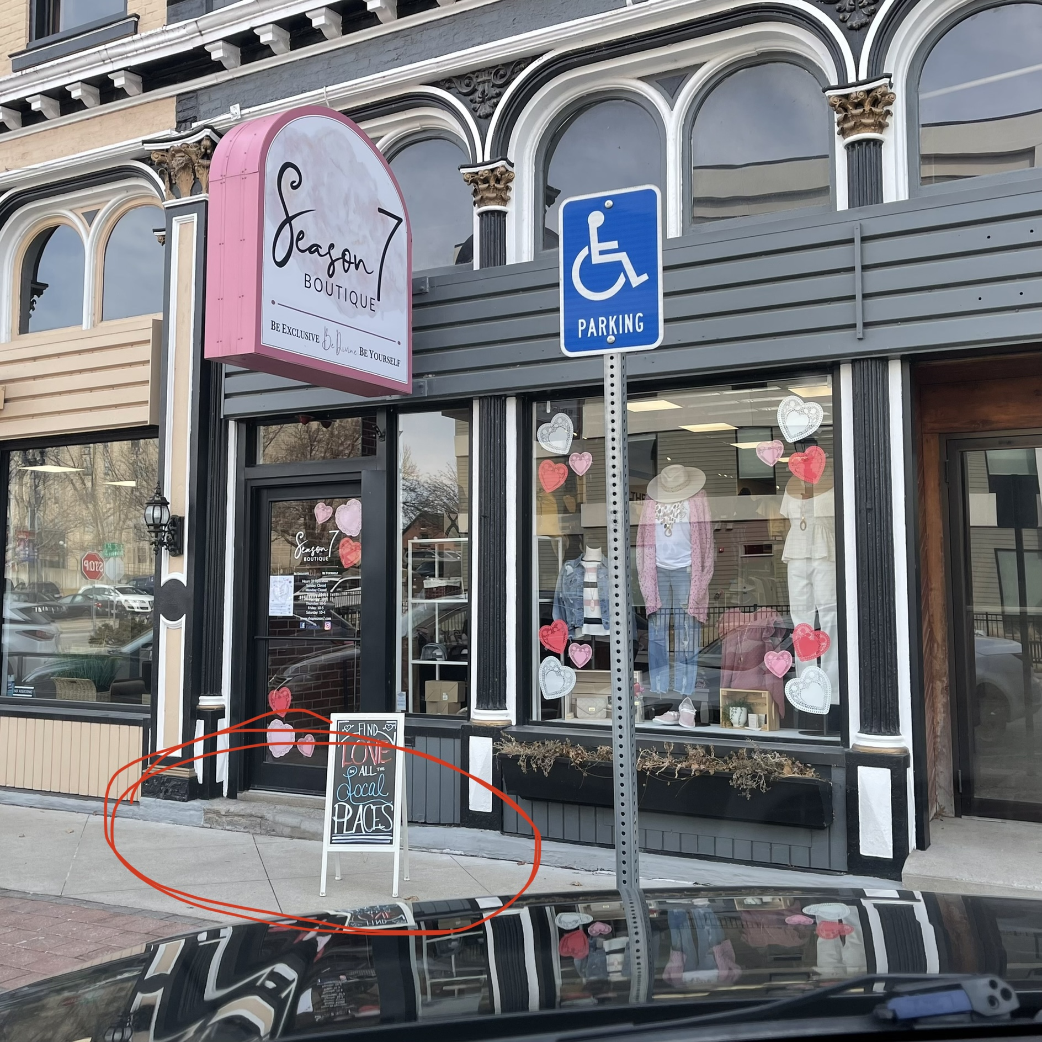
ADA Accessible Grant
Front Door Business Access
Up to $2,500 or 25% of the Cost
Concrete Ramp and Handrail
Submit Letter of Participation
Requires Contractor’s Quote
State Tax Credit Aligns Well (K-37)

Slide 4
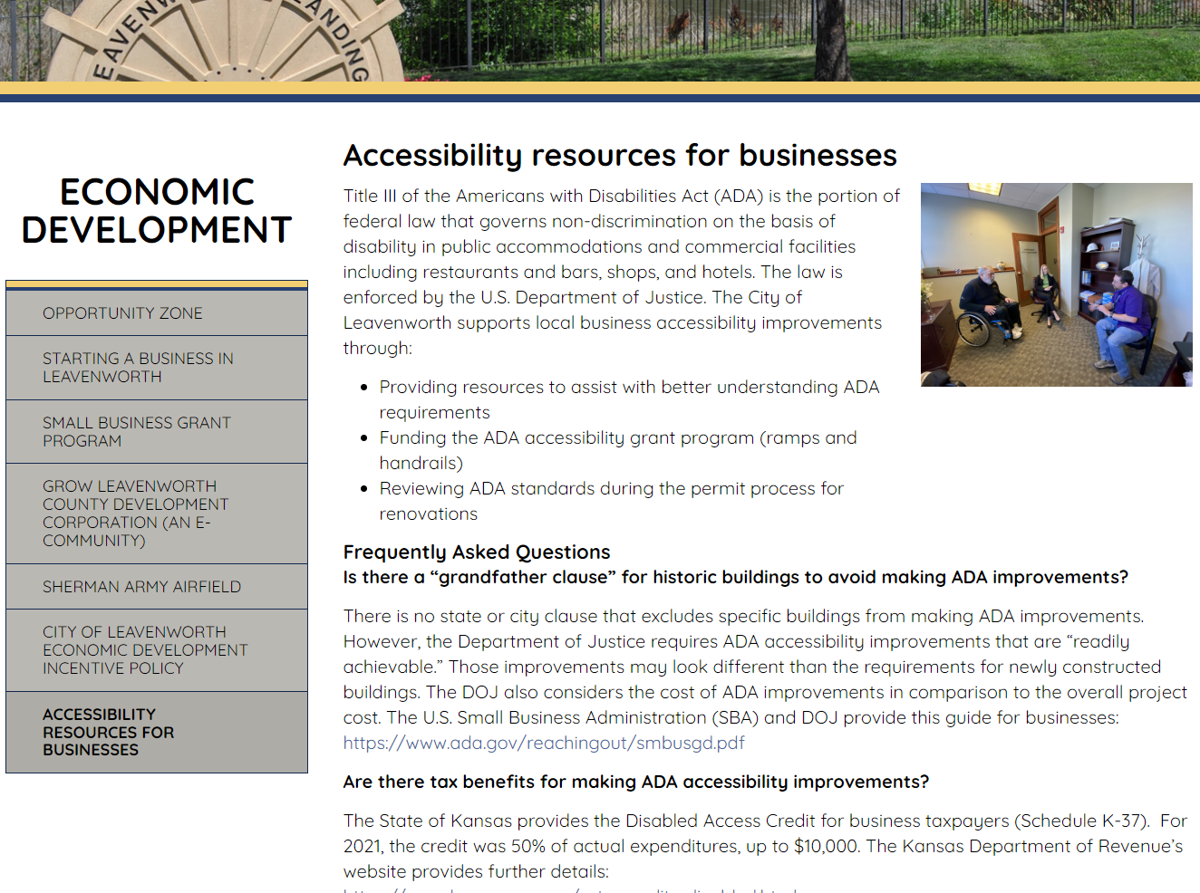
ADA Accessible Grant

Slide 5
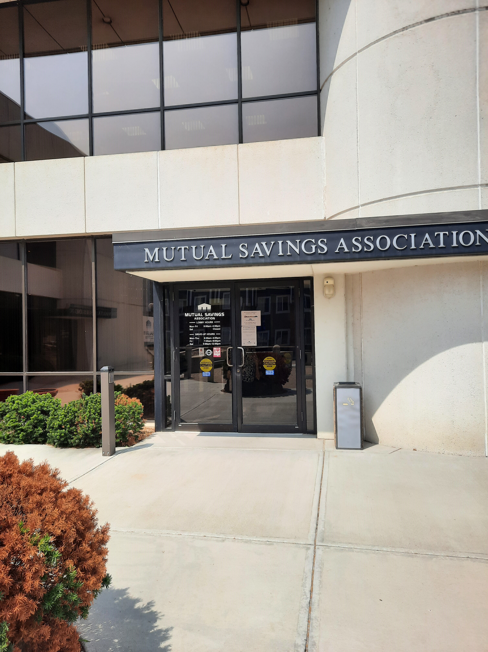
Business Improvement and Expansion Grant - NEW
For Interior ADA Improvements
For Installation of Fire Suppression (Sprinklers)
50% of Project Cost (Up to $30,000)
Funds First Come, First Serve
Program Ends December 2024
Application and Approved Contractor Quote

Slide 6
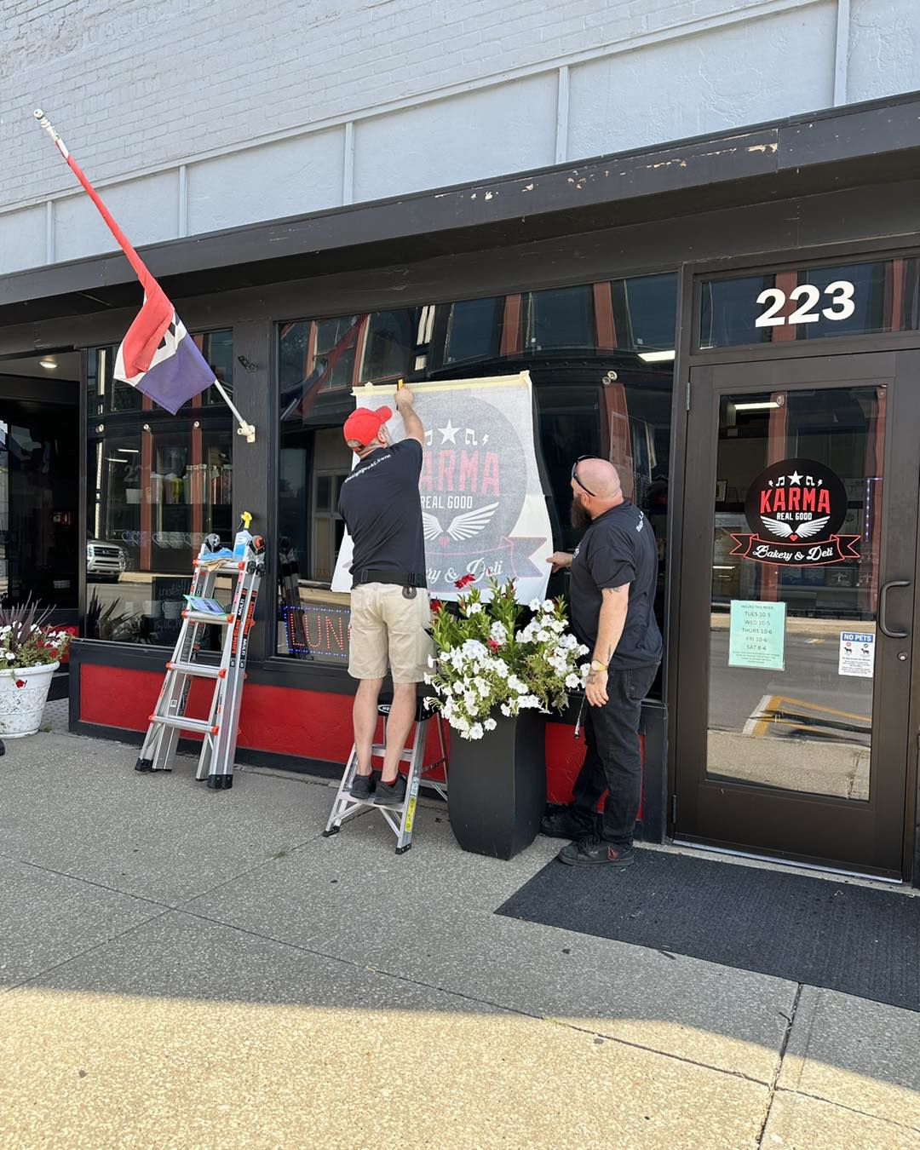
Small Business Economic Development Grant
For Signage, Façade Work and Building Improvements
50% of Project Cost (Up to $5,000)
Application and 2 Contractor Quotes
May Need City Permit
May Require Historic Preservation Approval
Two Year Wait After Grant

Slide 7
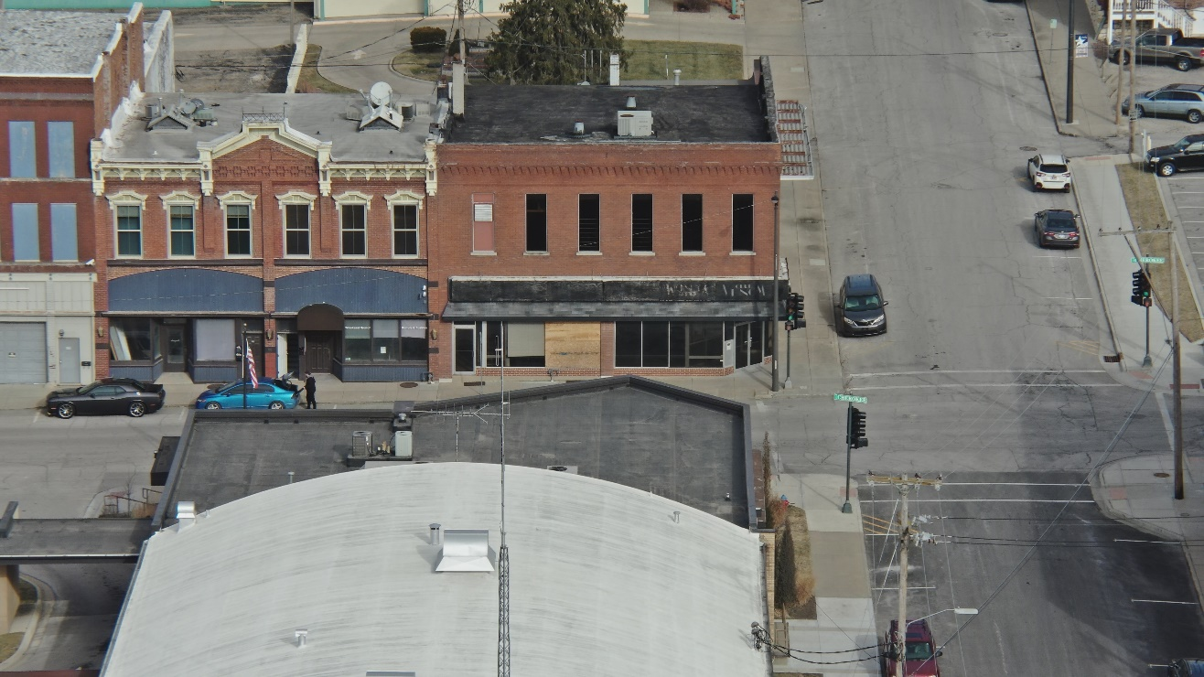
NRA Tax Rebate Program
Neighborhood Revitalization Area (NRA)
Property Tax Rebate Program
Be on the Map, Make Substantial Improvements
Based on Increased Taxable Value
Includes Residential

Slide 8
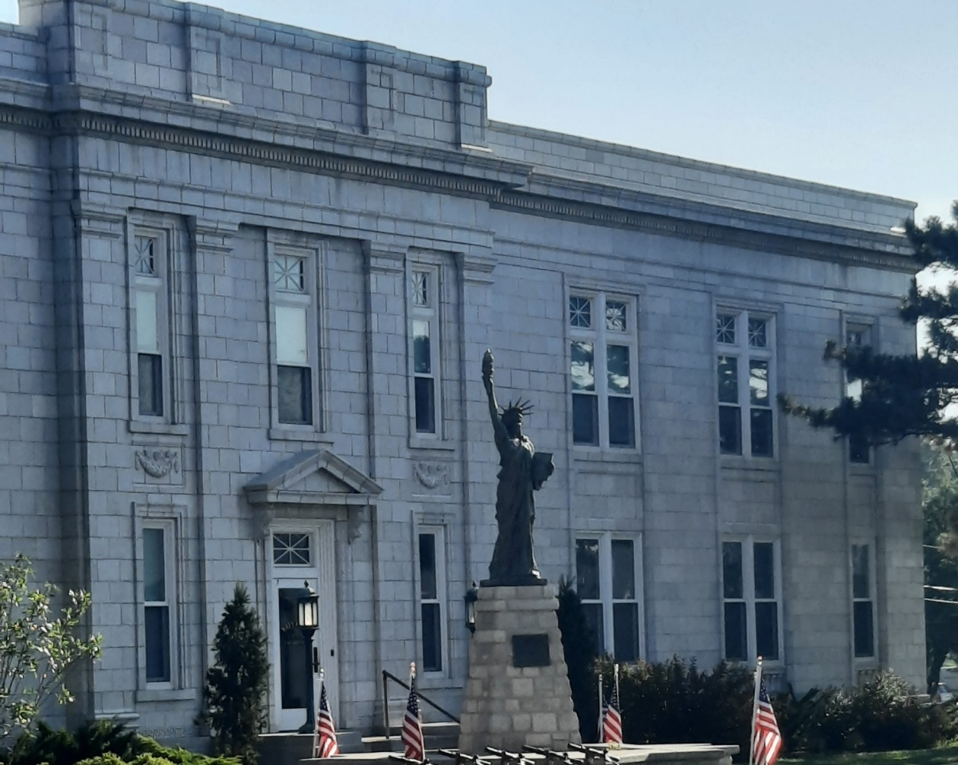
City Economic Development Department
Leavenworth City Hall (Downtown)
In-Person Meetings, Virtual Meetings or Phone Calls
Economic Development Incentives
Referrals to Partner Resources
Connections with Other City Departments (Planning, Fire Department, PW Building Inspections)

